Slide 1

Design, Develop, Implement, Test Document Used Car Sales Portal Website
Module Project
Module: Application Development & Process
Course: Applied Degree in Software Engineering
Start Date :
End Date :
Submission Date :
Learner Name :
Enrollment ID :
Presentation Date :
27 November 2022
Ida Bagus Ketut Yoghantara
12 Desember 2022
BDSE04-0322
12 Desember 2022

Slide 2
Document History
Version Number | Effective Date of release | Summary of Included Changes | Author
1 | 18 Nov 22 | First Edition | Nilofar

Slide 3
Contents
S. No. | Description
01 | Project background, objective & deliverables
02 | List of software used
03 | Business Process
04 | Project Plan
05 | Stages of Risk Based Testing models
06 | Types of risks
07 | Risk Based Testing Strategies
08 | Qualitative and Quantitative Risk Analysis
09 | Security Testing
10 | Test plans and Test cases
11 | Logs of Test Results
12 | Modifications of fail Test Cases
13 | Effectiveness of RBT strategy
14 | Project Results

Slide 4
1. Project Definition
Project Background
You have been approached by ‘ABC Cars Pte Ltd’ as a website developer to develop a Used Car Sales portal. Users will be able to register in the portal using the Registration Page. Users of the portal can search for Cars using Make, Model, Registration & Price Range. Users will be able to view the Car information after searching them. The portal allows users to login, post Car for sale.
Project Objective
There are 2 types of users in this Used Cars Sales portal. They are
Users
Administrator
Users should be able to perform following functions in the portal
Register in the Portal
Login to the Portal
Post a Car for Sale along with Picture upload
Deactivate an Existing car sale
Update their Profile after logging in.
Book an appointment for test drive
Post the bidding price

Slide 5
1. Project Definition
Administrators should be able to perform the following functions in the portal
Register in the Portal
Login to the portal
View List of Registered Users
Mark a User as Administrator
Activate / Deactivate a Car post
Update their profile
Approve or deny the users appointment based on the bidding
Transact the sales if price is right
Both Users & Administrator
Visit Home Page
View Car Listing
Search for a Car by Make, Model, Registration Year & Price Range
About Us Page
Contact Us Page

Slide 6
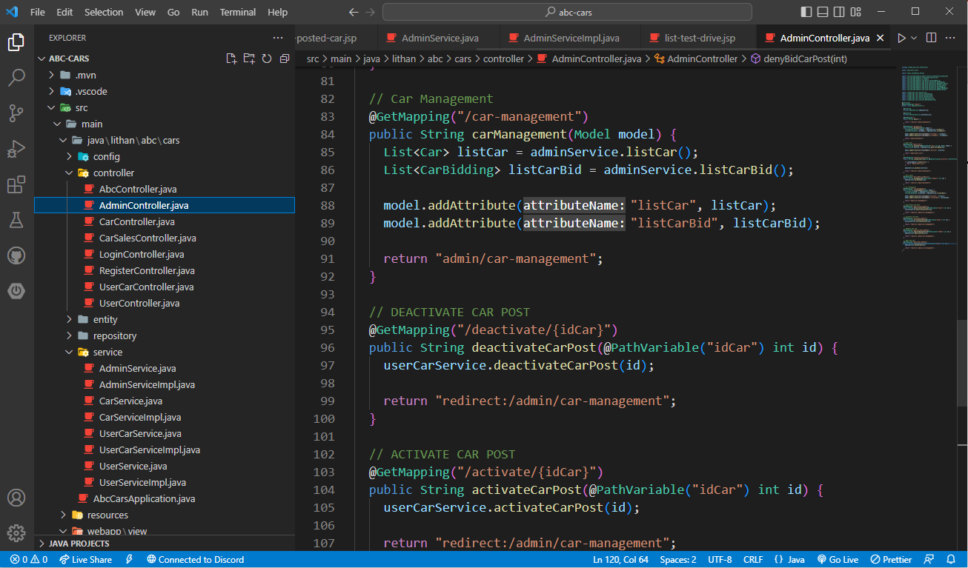
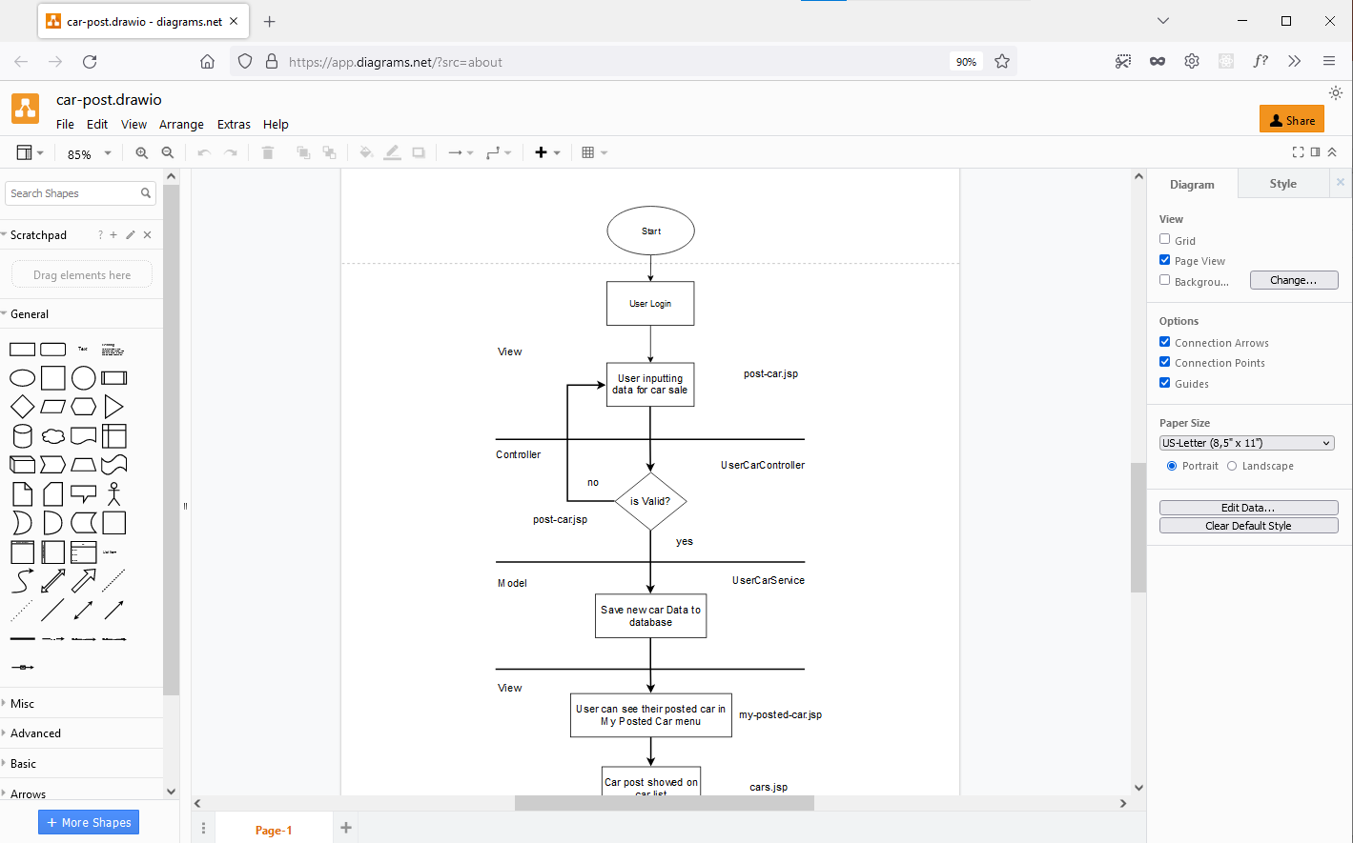
2. List of software used
Visual Studio Code
Diagram.net

Slide 7
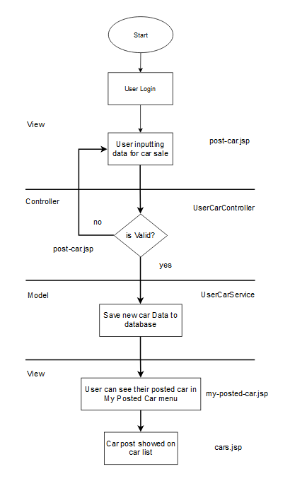
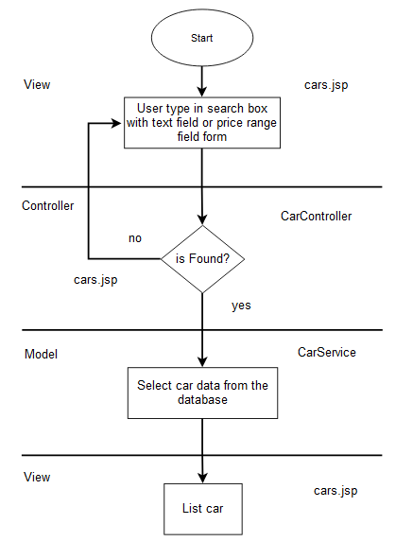
3. Business Process
Post Car
Search Car

Slide 8
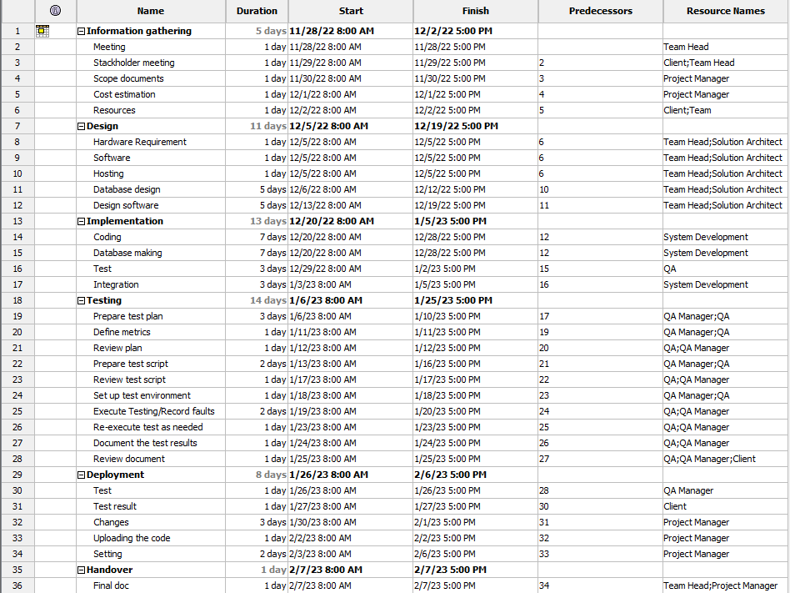
4. Project Plan

Slide 9
5. Stages of Risk Based Testing models
What is the risk? Risk Management is a multi-step process that identifies and evaluates any emerging threats or risks, whether internal or external, to a business’ information systems and data. It is essential to maintain a risk management process because it reveals all potential threats within the business, whether they already exist or before they generate a negative impact.
Risk Based Testing Stages
Risk identification Identify as many of these risk factors as possible. Anything that can harm your organization should be on your radar, including natural disasters, technological risks, and single point of failure (SPOF) risks.
Plan risk strategy A risk management strategy provides a structured and coherent approach to identifying, assessing and managing risk.
Assess risk Identify hazards and risk factors that have the potential to cause harm

Slide 10
5. Stages of Risk Based Testing models
Mitigate risk If a risk presents an unwanted negative consequence, you may be able to completely avoid those consequences
Report risk A risk report is a summary that describes the potential risks a company may face.
Predict risk from the lesson learned Risk Analyser adds extra discipline to performance measurement and project control. It provides reporting that shows you where to focus resources, how to justify expenditure on mitigation actions, and brings managers the confidence that project success

Slide 11
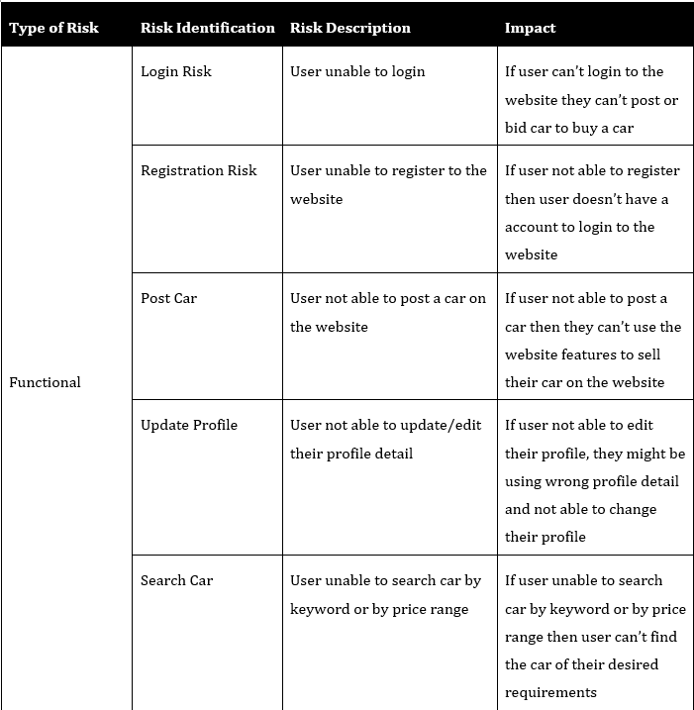
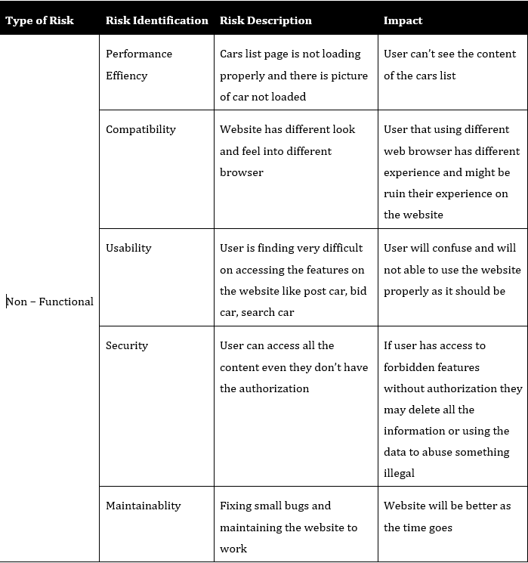
6. Types of risks

Slide 12
7. Security Testing
Test Scenario | Authentication and Authorization
TS003
Test Cases
TC001 | Validating login user with bad credential
TC002 | Check access website from user with role “USER” and user with role “ADMIN”
Test Scenario ID | Test Case ID | Test Priority | Pre-conditions | Expected Result | Actual Result | Final Result
TS003 | TC001 | High | ABC Cars Sale Portal Website hosted on server and create 2 user with role ”USER” and role “ADMIN” | When user inputting wrong username or password it will show error “Username or password invalid” | As expected | Pass
 | TC002 | High |  | “USER” Role has access to post car, place car bid, appoint test drive “ADMIN” Role has access to admin dashboard and website car sales management | As expected | Pass

Slide 13
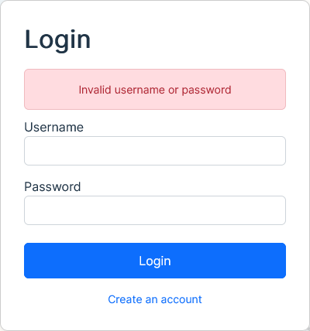
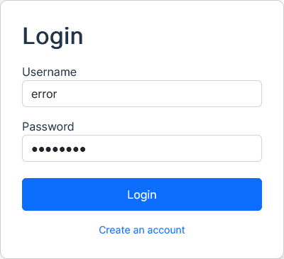
7. Security Testing
Test Scenario ID | Test Case ID | Test Data
TS003 | TC001 | Username = error Password = error123
 | TC002 | Username = user Password = user123 Username = admin Password = admin123
Authentication

Slide 14
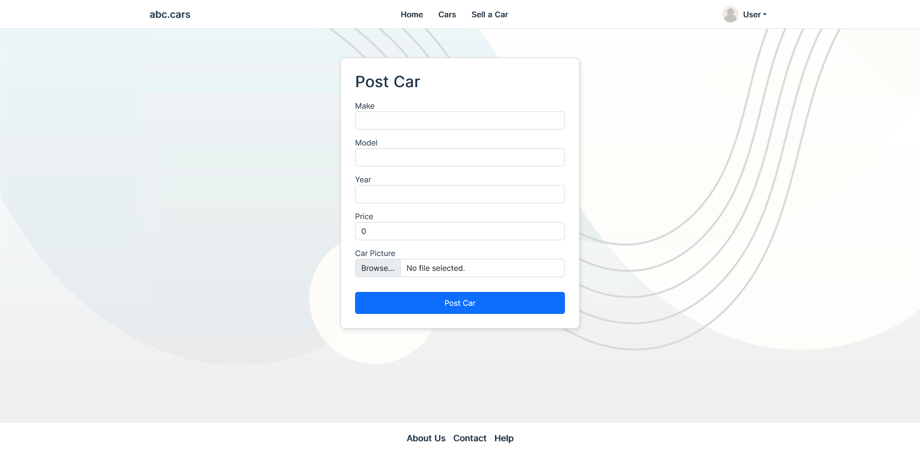
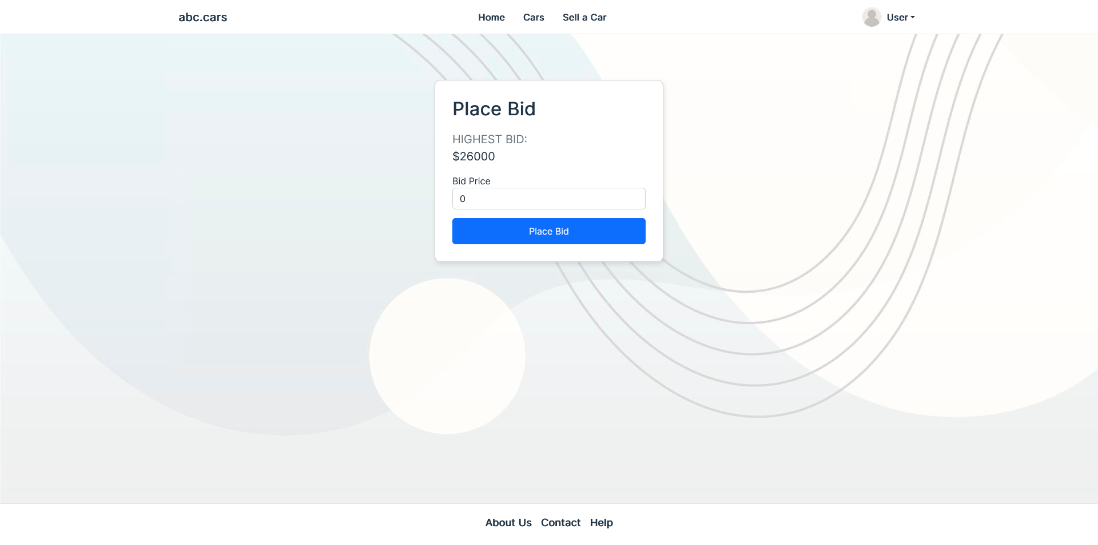
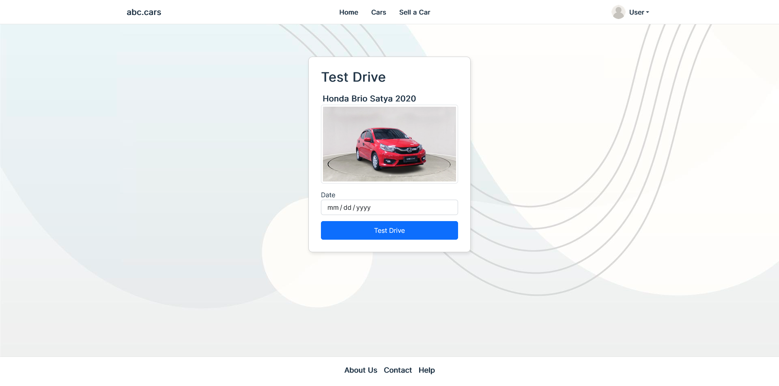
7. Security Testing
Role USER

Slide 15
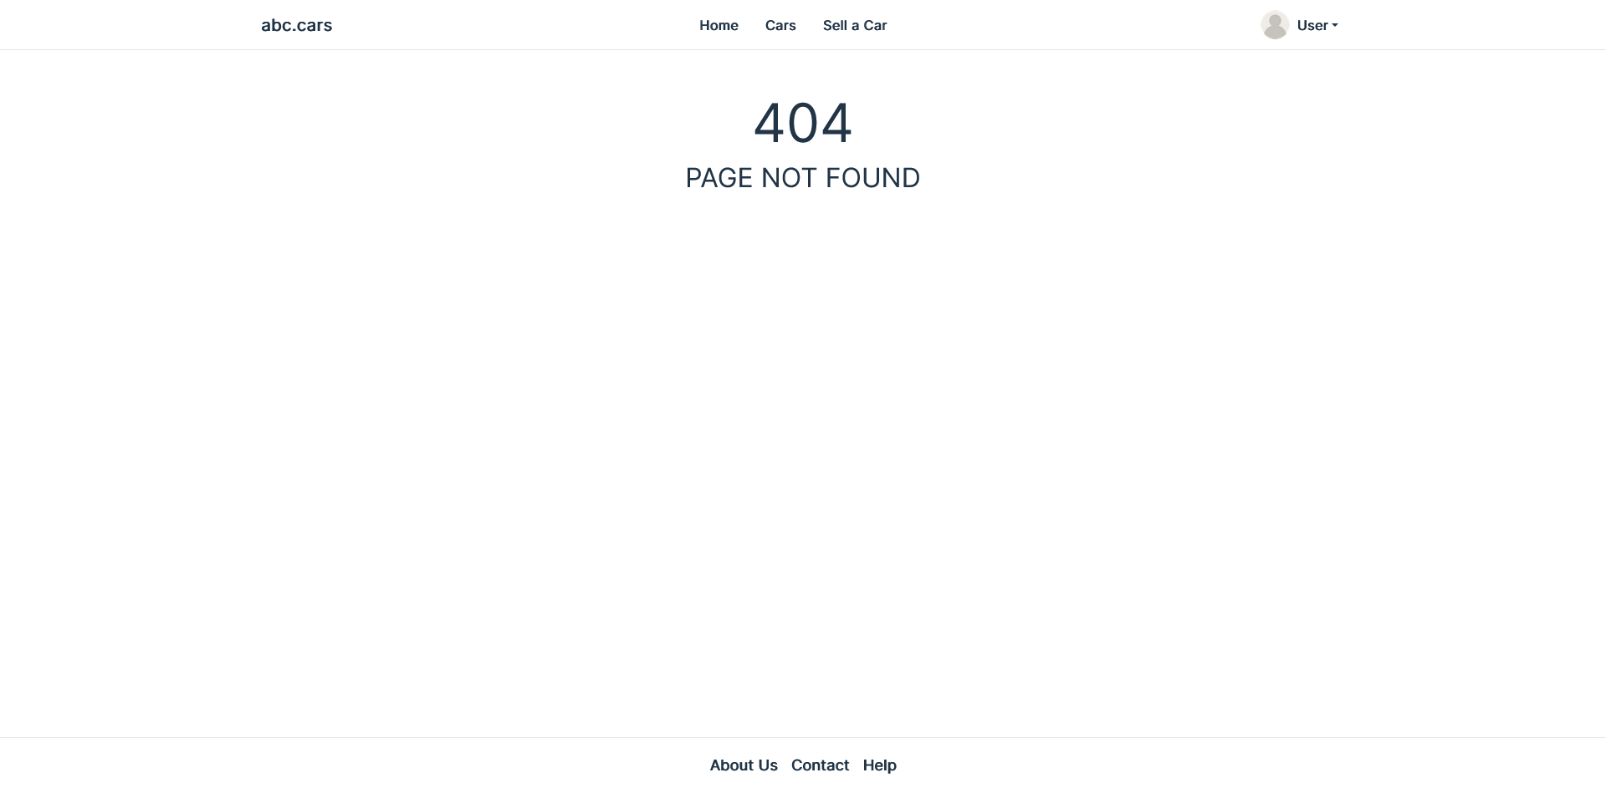
7. Security Testing
Role USER

Slide 16
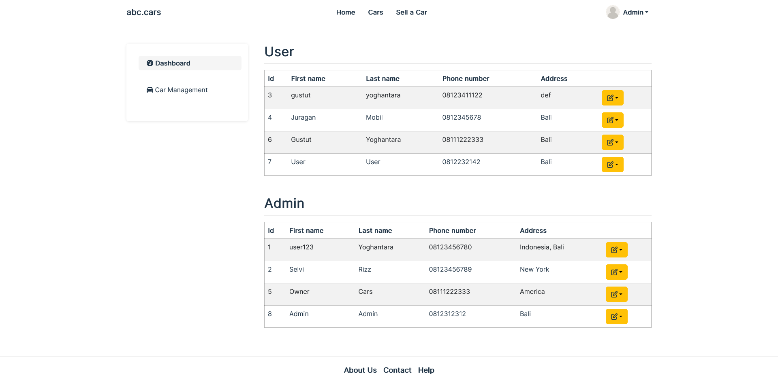
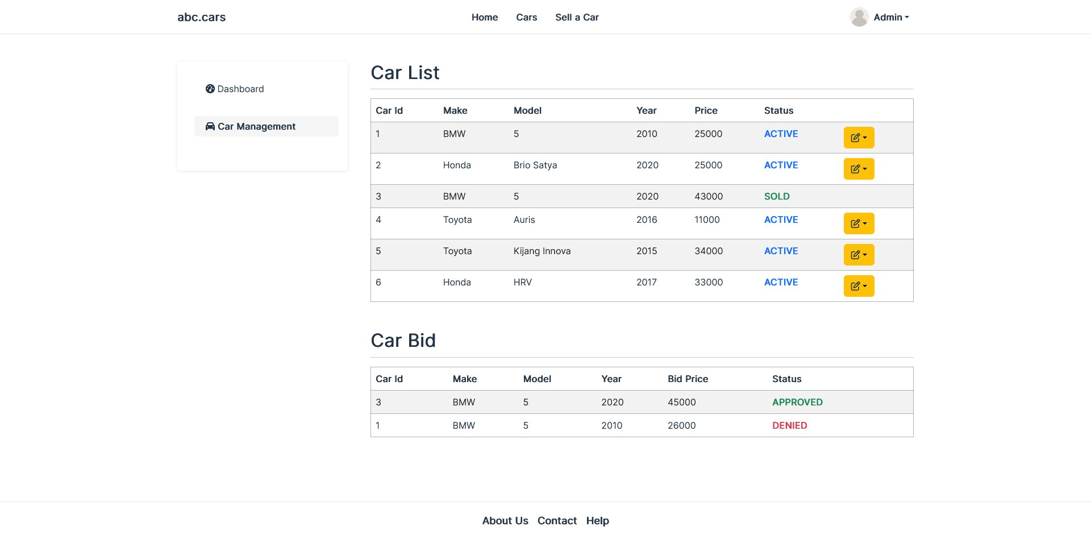
7. Security Testing
Role ADMIN

Slide 17
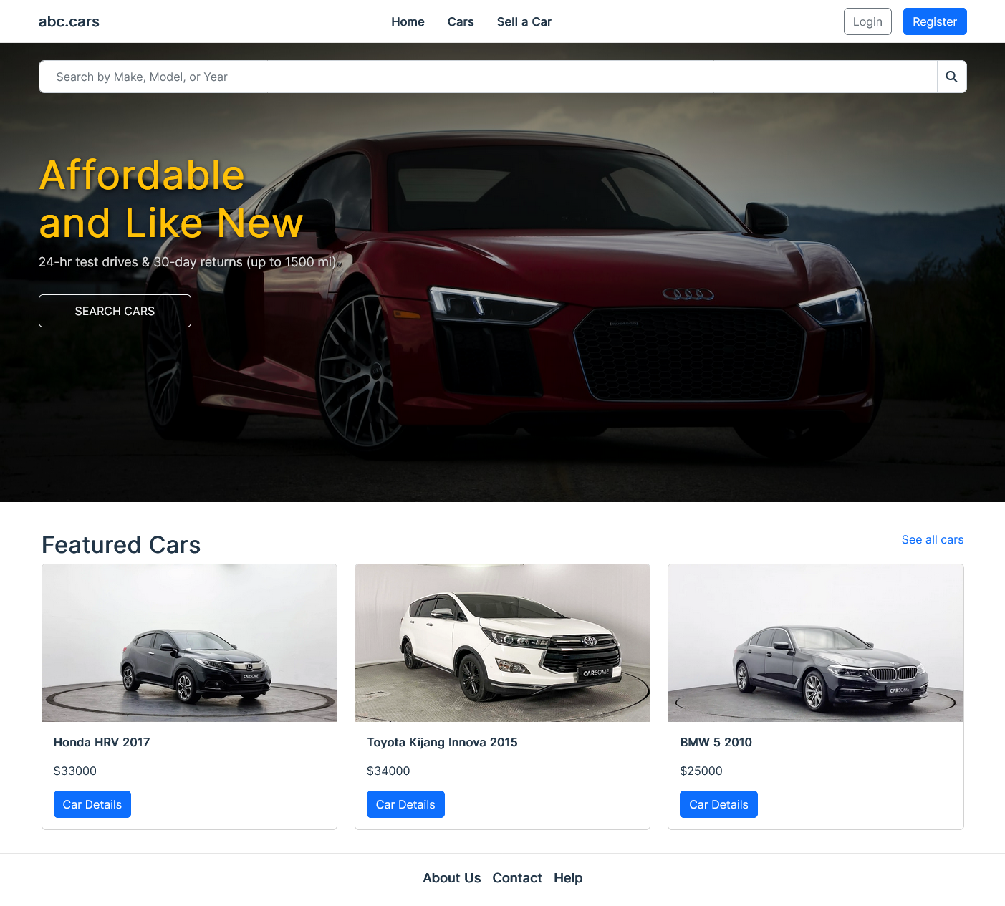
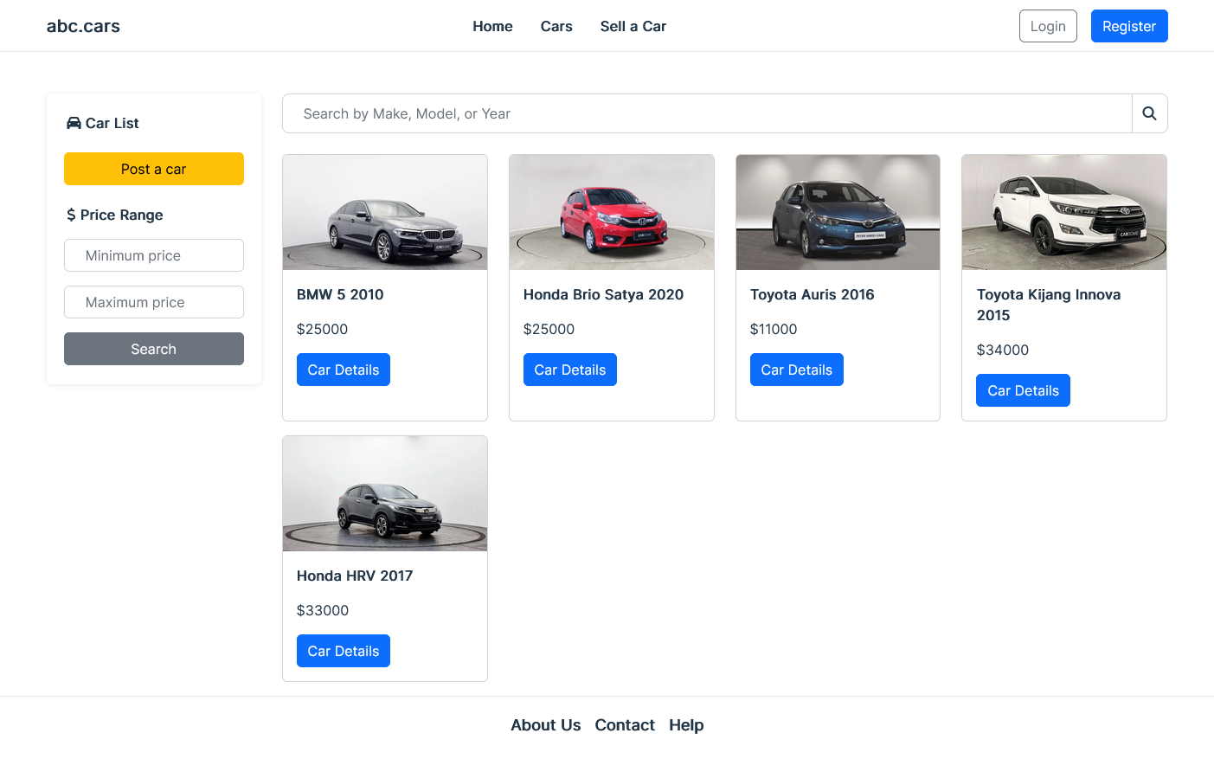
8. Project Results

Slide 18
Thank you

